Slide 1

Data Integration & BI Automation Internship
Presenter: Vladislav Stoimenov, 235030

Slide 2


Company
Company name: Move Intermodal (Van Dijk Logistics)
Industry: Logistics – FTL Intermodal Transport
Core activity:
  Full-container intermodal transportation
  Clients book one complete container, fill it with their own goods, and pay per container
  Transport uses multiple modes (road, rail, and water) within one end-to-end solution
Main corridor: BENELUX <-> Italy
Department: IT Department / Business Intelligence Team
Role: Data Integration & BI Automation Intern

Slide 3
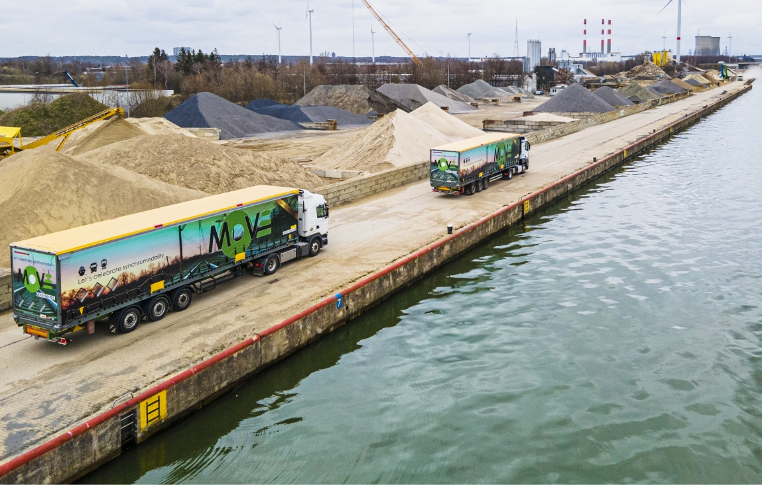
Project details
Project summary:
Automating reporting for a newly acquired business unit using a scalable data model.
Main business problem:
Reporting was fully manual, based on Transpas (TMS) exports and Excel calculations, making it inefficient and error-prone.
Main goal of the project:
To build a structured data model that automates data flows and reporting for Van Dijk.
Notes:
Project Details
Project summary
Automating the reporting of a newly acquired business unit by designing a scalable data model and data flow.
Main business problem
Van Dijk Logistics, a newly acquired business unit within Move Intermodal, relied on manual reporting based on Transpas data exports, Excel calculations, and manually created reports. This process was time-consuming, error-prone, and difficult to scale.
Main goal of the project
To design and implement a structured data model that enables automated data flows and reporting for Van Dijk, replacing manual processes with a reliable and scalable solution.

Slide 4





Tools and Technologies
Snowflake: Cloud data warehouse and querying
Matillion: Data integration and data modelling
SQL: Data transformation and querying
Bold BI: Reporting and dashboards (connected to Snowflake)
Data Vault 2.0: Data modelling methodology for scalable and historical data integration
Ixolution: TMS system of Move Intermodal
Transpas: TMS system of Van Dijk Logistics
Notes:
Project Details
Project summary
Automating the reporting of a newly acquired business unit by designing a scalable data model and data flow.
Main business problem
Van Dijk Logistics, a newly acquired business unit within Move Intermodal, relied on manual reporting based on Transpas data exports, Excel calculations, and manually created reports. This process was time-consuming, error-prone, and difficult to scale.
Main goal of the project
To design and implement a structured data model that enables automated data flows and reporting for Van Dijk, replacing manual processes with a reliable and scalable solution.

Slide 5
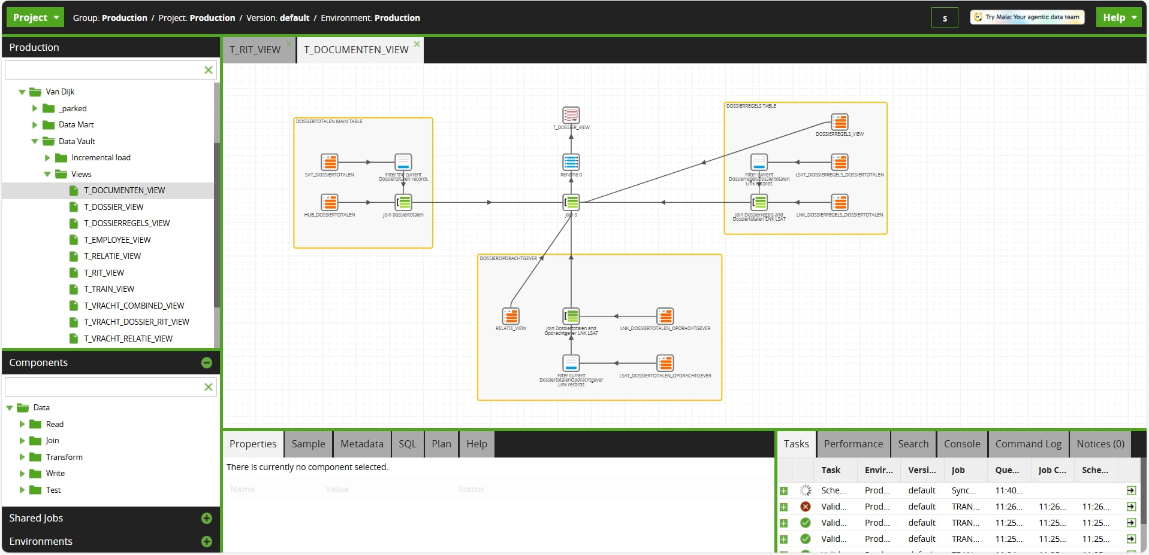

Slide 6
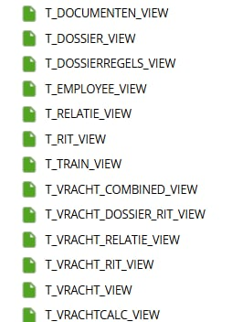

Contribution
Analysed staging and raw database tables
Selected relevant data for reporting use cases
Designed Data Vault 2.0 links to store historical data
Built incremental pipelines for automated data flow
Performed detailed data mapping to Move’s existing data model
Created automated reporting views connected to Bold BI
Notes:
“For this project, Snowflake was used as the central cloud data warehouse, where all integrated data is stored and queried.
Matillion was the main tool for data integration and data modelling. I used different Matillion components such as Table Inputs, Joins, Rename, Filters, and SQL components to build the data model and implement the data transformations.
SQL was used both within Matillion and directly in Snowflake for querying and validating the data.
The data model itself follows the Data Vault 2.0 methodology, which separates business keys, relationships, and descriptive attributes. This approach makes the model scalable, auditable, and suitable for handling historical changes in the data.
Finally, Bold BI was connected to Snowflake to build the final analytical views and dashboards used for reporting.”

Slide 7
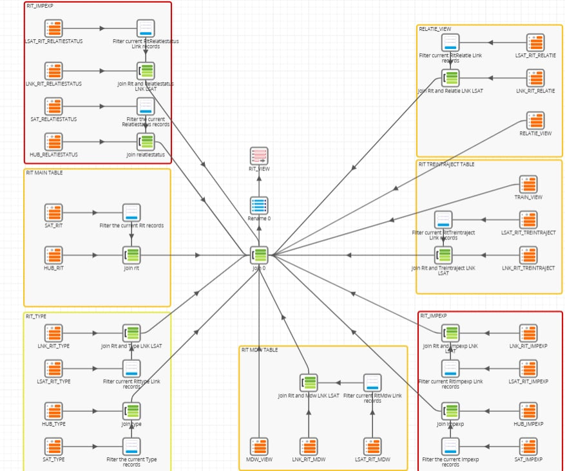

Slide 8
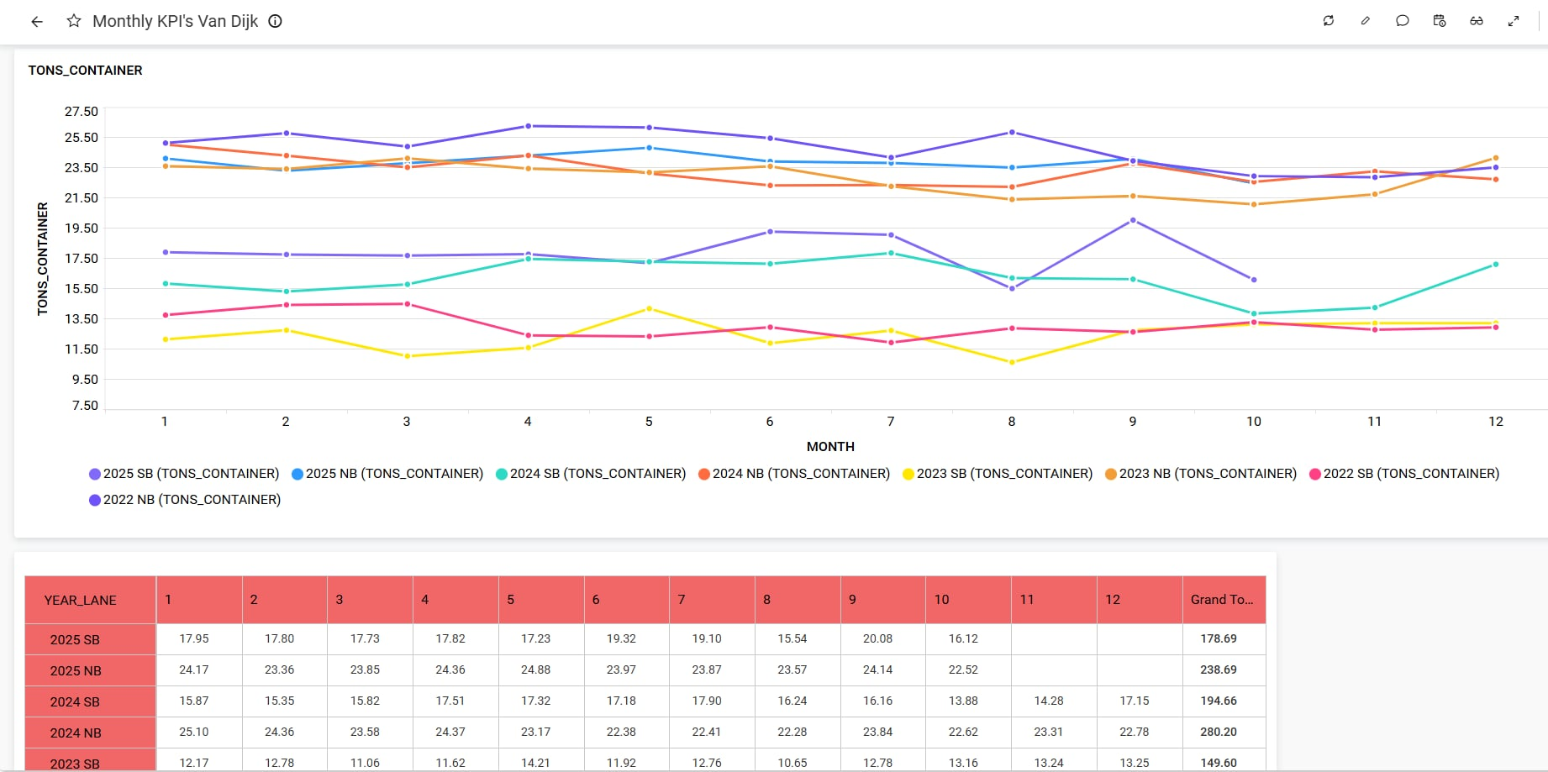

Slide 9
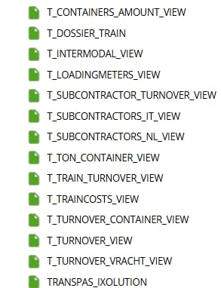
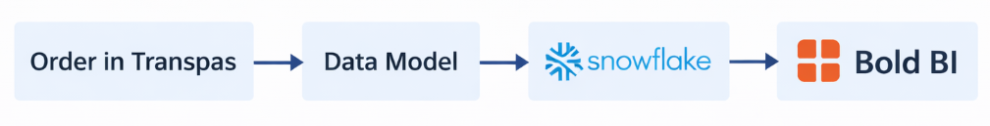
Results
Report views are built and automated in Bold BI
Data mapping to Move’s existing data model is complete
Data flow from Transpas (TMS) to Bold BI is implemented
Any remaining views are in final stage and will be completed soon
Data update schedulers configuration and stakeholder validation are planned for the next week
Notes:
“My contribution started with a detailed analysis of the staging data and raw tables available in the database. I explored the source system structures and evaluated which tables and fields were relevant for reporting purposes, and which could be excluded.
Based on this analysis, I selected and modelled the relevant entities and, following Data Vault 2.0 concepts, created links between them based on the business keys of the tables. This ensures that relationships are stable over time and that historical changes in the data can be stored correctly.
When linking the data, I created multiple intermediate views using Matillion components such as joins, filters, renames, and SQL components. These views were used to progressively connect and prepare the data before loading it into the final model. I will show screenshots of some of these views to illustrate how the data was connected and transformed.
I then focused on building incremental pipelines for the data flow, ensuring that only new or changed records are processed during each load. This approach improves performance and makes the solution scalable as data volumes grow.
A significant part of the work involved data mapping to Move Intermodal’s existing data model. This included column-level and value-level mapping, implementing business calculations, and standardising data formats to ensure consistency with existing reporting definitions.
Finally, I translated the logic of the manual reports into automated analytical views and connected them to Bold BI. As a result, the reports are automatically updated whenever new records enter the TMS system, removing the need for manual exports and calculations.”

Slide 10
Challenges & limitations
Limited domain knowledge of Van Dijk operations within the Move team
Dependency on stakeholder availability for data validation
Delays in aligning reporting requirements across teams
Limited transparency on existing TMS extract logic

Slide 11
Thank you for your attention!
Presenter: Vladislav Stoimenov, 235030

